Slide 1

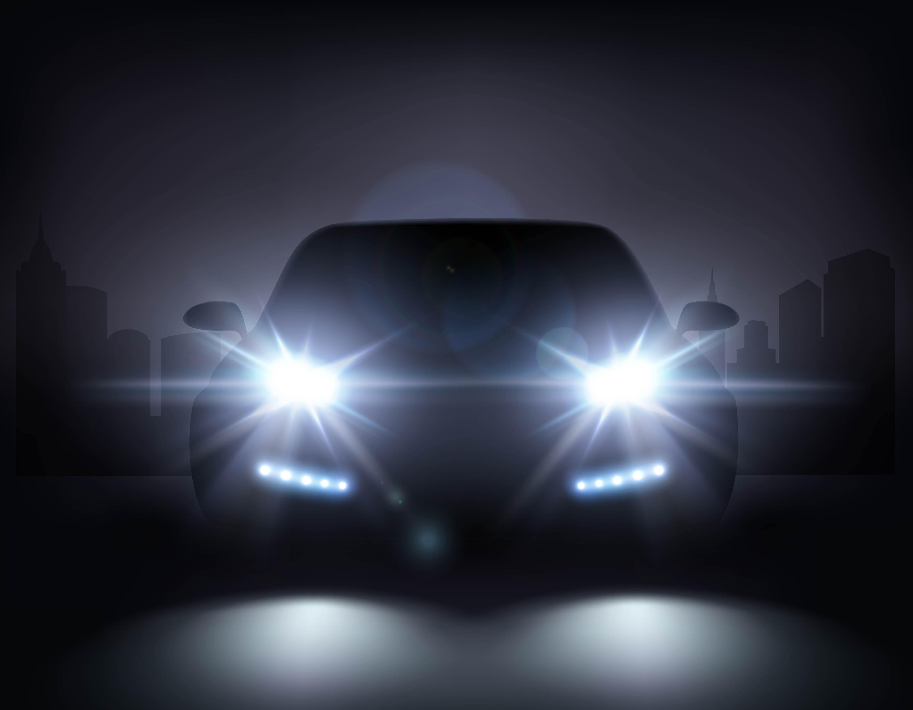
Headlight glare: Myriads of Complaints. Are We Listening?
Detroit Lighting Workshop – Glare Forum
September 8, 2025
Naomi J Miller, FIES, FIALD
Retired Lighting Nerd
Emerita, Pacific Northwest National Laboratory
Image by Macrovector on Freepik

Slide 2

Cocktail party question: What do YOU do??
Really??
Can you fix that awful glare from those bluish headlights?
Notes:
Then, they tell me that they’ve stopped driving at night because the glare prevents them from seeing the road and pedestrians….

Slide 3

#1 Reason headlights are so bad
Because no one buys a car based on how
painful its headlights are for the oncoming driver
PV Productions from Freepik.com
Notes:
Instead, they buy the car because the headlights help them see the world in front of them at night….

Slide 4
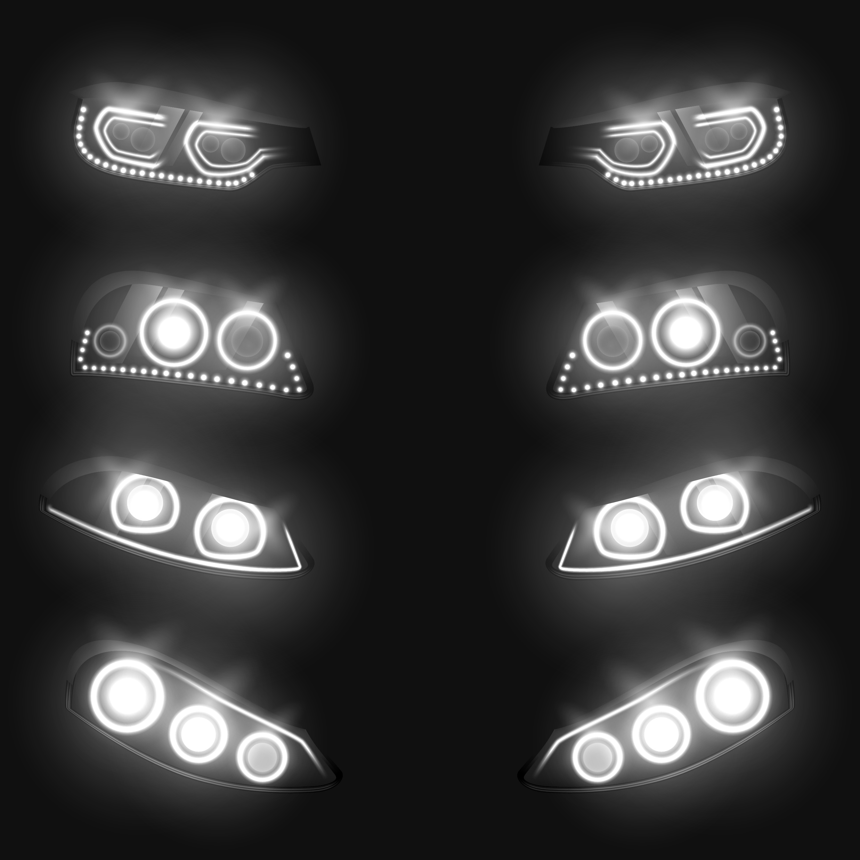
#2 Reasons headlights are often awful
LEDs are small and BRIGHT. When viewed from a distance, eye optics overlap the intensities, resulting in greater perceived intensity than illuminance at the eye would predict
Vectorpocket from Freepik.com
Notes:
Easily over 1 and 2 million candelas/m2

Slide 5
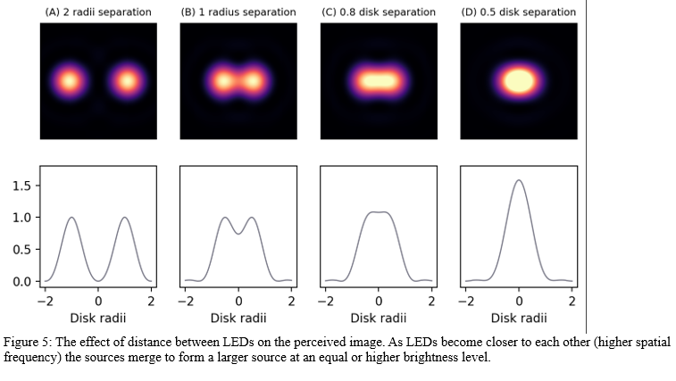
Notes:
Easily over 1 and 2 million candelas/m2

Slide 6

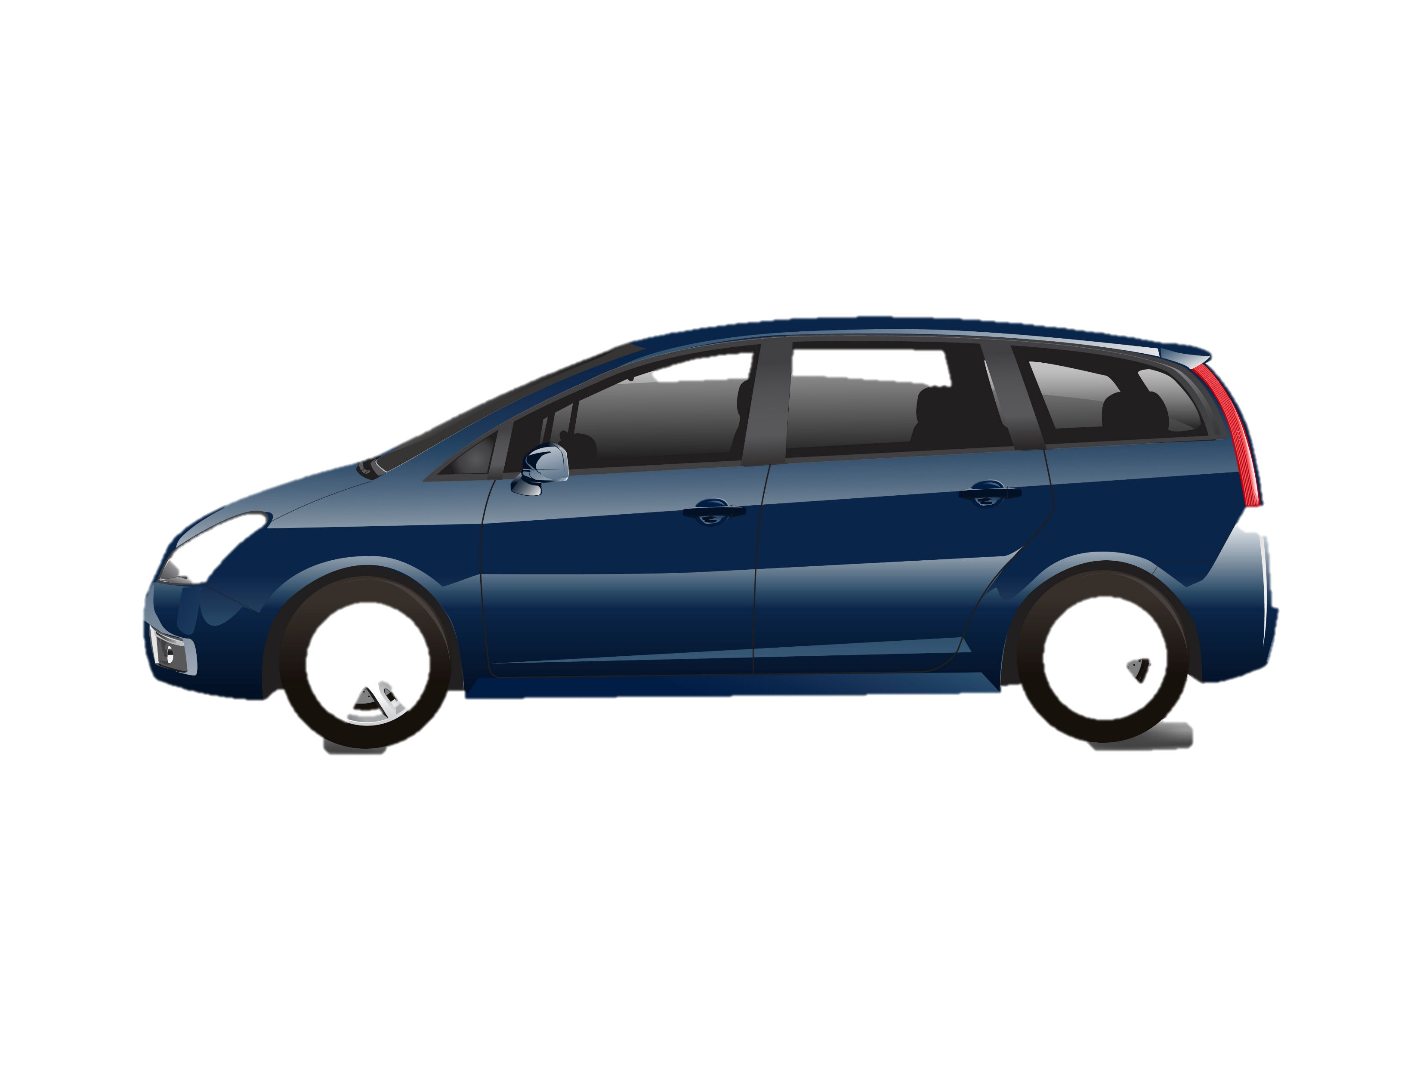
#3 Reasons headlights are often awful
Sharp upper beam cutoff in taller vehicles means lower car drivers are in the MAX INTENSITY zone.
Image by rawpixel.com on Freepik
tayyabarayyan121 from Freepik.com
Notes:
Story of Scott in Tesla with 2” diameter smaller tires

Slide 7
#4 Reasons headlights are often awful
Center of required light distribution is relative to the headlight, not the height above the roadway.
Image by rawpixel.com on Freepik
tayyabarayyan121 from Freepik.com
Notes:
Both vehicles could have identical headlight distributions, but the taller one would be more glaring.

Slide 8
#5 Reasons headlights are often awful
The blue-white light is most often perceived as being more glaring. Might warmer CCT be a selling point?
Image by rawpixel.com on Freepik
tayyabarayyan121 from Freepik.com
Notes:
It may be due to rods and cones having different spectral sensitivities.

Slide 9
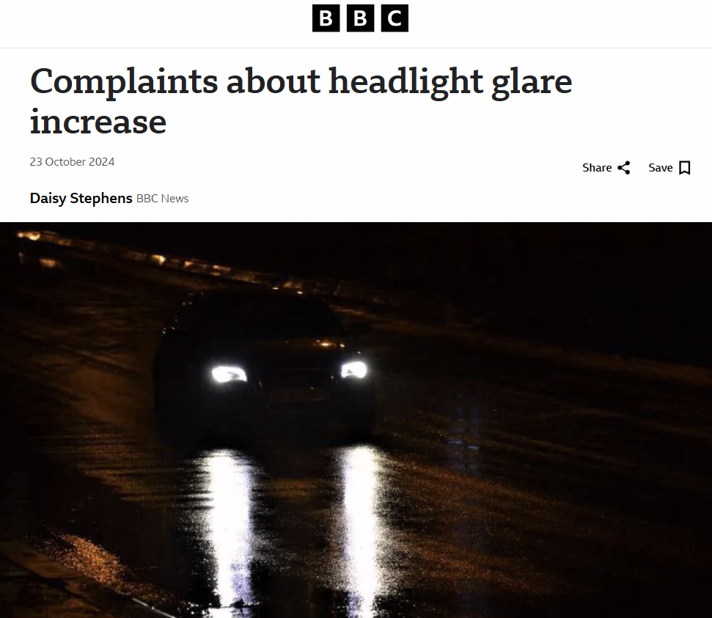
Summary: We need to LISTEN to the complaints. Modify the headlights and the standards. Naomi Miller naomi@NMLightingDesign.com Oberlin OH
Notes:
It may be due to rods and cones having different spectral sensitivities.

