Slide 1
A Few Old Notes About Glare
Daniel Stern, DVN

Slide 2
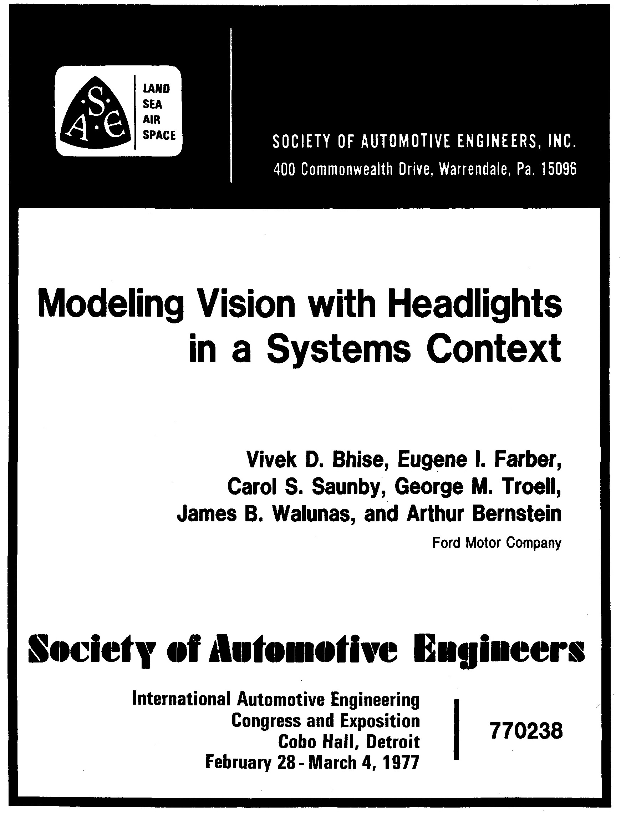
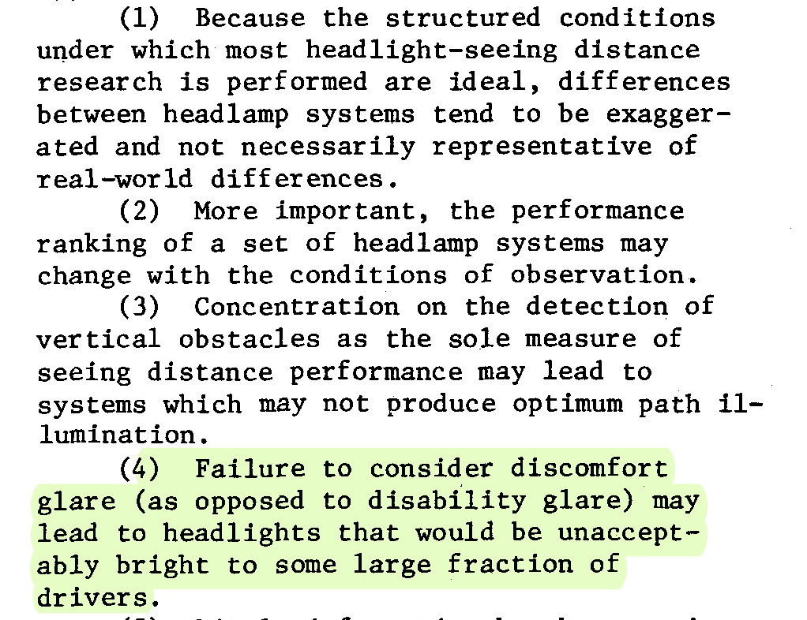
Vivek Bhise et al · Ford (USA) · 1977
"Failure to consider discomfort glare (as opposed to disability glare) may lead to headlights that would be unacceptably bright to some large fraction of drivers."

Slide 3
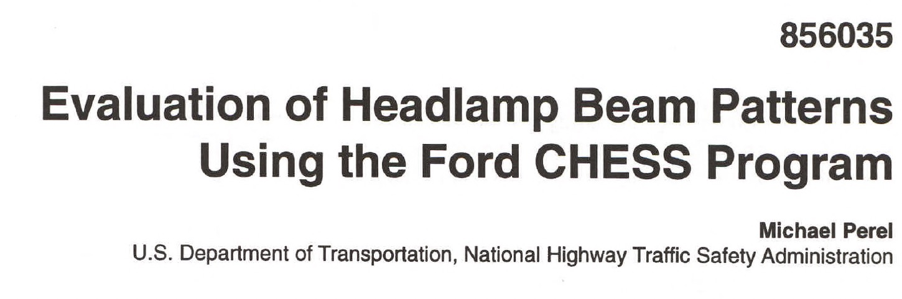
Michael Perel · NHTSA · 1985

Slide 4
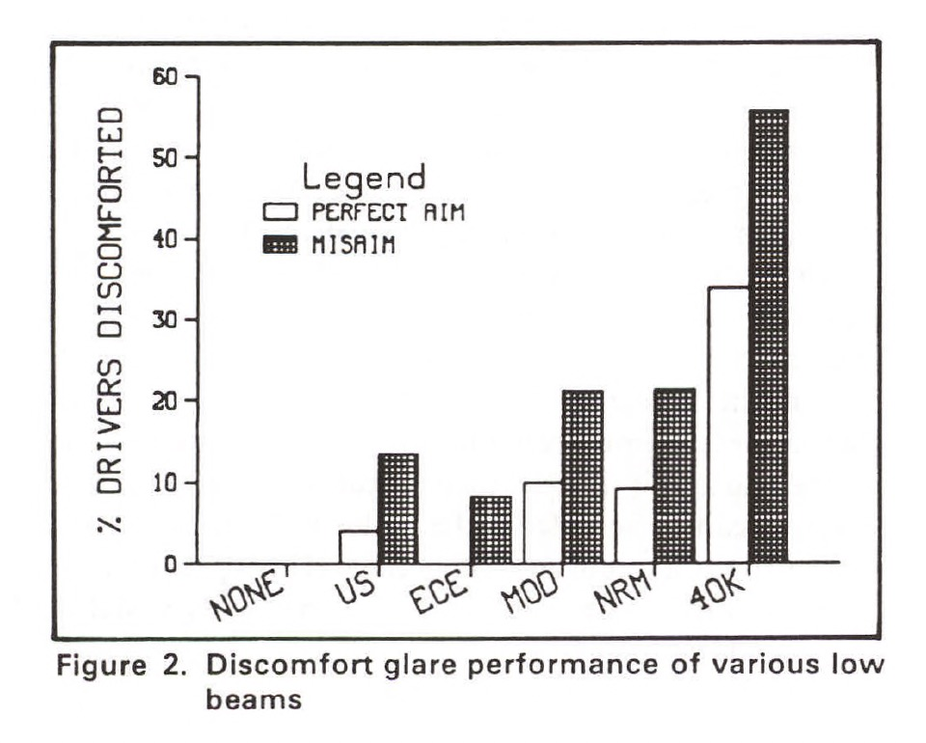
Michael Perel · NHTSA · 1985
"The 40K beam, because of its high intensity, has the worst discomfort (Figure 2). The figure also shows the strong influence of misaim on discomfort. The difference in performance between misaim and perfect aim conditions for the same beam can be as great as the magnitude of the differences between beams. Since misaim is a fact of life for all headlamps. these results emphasize the importance of evaluating beam design under realistic misaim conditions."

Slide 5
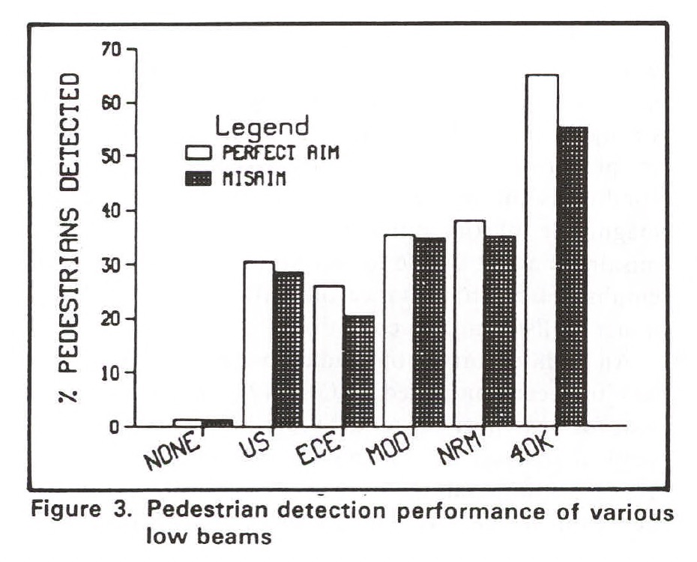
Michael Perel · NHTSA · 1985
"The 40K beam (40,000 cd below H and ~0 cd above H) appears to be a good performer in pedestrian detection…"

Slide 6
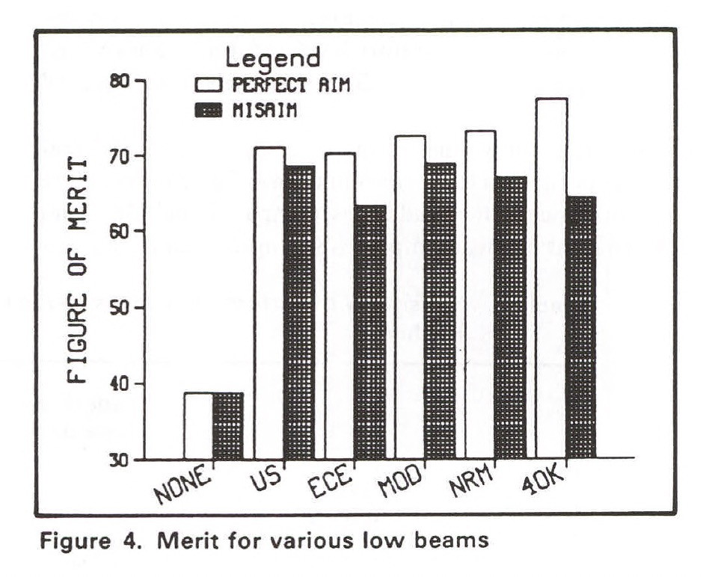
Michael Perel · NHTSA · 1985
"…however, the discomfort glare of this lamp is high. Discomfort glare is weighted considerably less than pedestrian detection in the calculation of the figure of merit, [but] when the various performance measures are combined over the entire simulated test route to compute the figure of merit (Figure 4), the performance of the 40K lamp is not greatly different from the other beams. Misam results in further reduction in the 40K lamp's FOM.

Slide 7
Vivek Bhise et al · Ford (USA) · 1977
"Failure to consider discomfort glare may lead to headlights that would be unacceptably bright to some large fraction of drivers."
Michael Perel · NHTSA · 1985
"The inverse-square law and log response of the eye mean a large intensity is needed to gain even a small increase in detection distance. Some critical target locations coincide with oncoming drivers' eyes, further increasing the difficulty of satisfying all criteria."

